Slide 1


Evaluating the Content and Quality of Next Generation Assessments
Amber M. Northern
Senior VP for Research, Fordham Institute
Sheila Schultz
Manager, Educational Policy Impact Center, HumRRO
February 2016

Slide 2

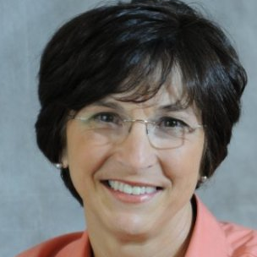



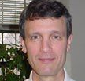
The Fordham Team
Amber Northern
Senior VP for Research,
Thomas B. Fordham Institute
Nancy Doorey
Educational consultant with assessment-policy expertise
Victoria Sears
Research Manager,
Thomas B. Fordham Institute
Morgan Polikoff
Assistant Professor at the University of Southern California and expert in alignment methods
Charles Perfetti
ELA/Literacy Content Lead and Distinguished Professor of Psychology at the University of Pittsburgh
Roger Howe
Math Content Lead and Professor of Mathematics at Yale University

Slide 3
The HumRRO Team
Sheila Schultz
Manager, Educational Policy Impact Center
HumRRO
Rebecca (Becky) Norman Dvorak
Senior Scientist, Educational Policy Impact Center
HumRRO
Hillary Michaels
Director, Education Research
HumRRO
Caroline (Carrie) Wiley
Senior Scientist, Educational Policy Impact Center
HumRRO

Slide 4



Project Partners
Developed and published the content alignment methodology
Implemented methodology
(high school)
Implemented methodology (grades 5 & 8)
Conducted reviewer training (TBFI)
Funders supporting the study

Slide 5
Study Overview
This study evaluates the content, quality, and accessibility of assessments for grades 5, 8, and high school for both mathematics and English language arts (ELA/Literacy)
Evaluation criteria drawn from the content-specific portions of the Council of Chief State School Officers’ (CCSSO’s) “Criteria for Procuring and Evaluating High Quality Assessments”
Aims to inform educators, parents, policymakers and other state and local officials of the strengths and weaknesses of several new next-generation assessments on the market (ACT Aspire, PARCC, Smarter Balanced)—as well as how a respected state test (MCAS) stacks up

Slide 6
Study Components
Phase 1
Item Review: Operational Items and Test Forms
Generalizability (Document) Review: Blueprints, Assessment Frameworks, etc. (subset of item reviewers)
Phase 2
Aggregation of Item Review and Generalizability Results and Development of Consensus/Summary Statements
Phase 3
Accessibility “Light Touch” Review (joint review)
  Generalizability (Document) Review: Accessibility and Assessment Frameworks, etc.
  Exemplar Review: Operational or Sample Items

Slide 7
Review Panels and Design
We received over 200 reviewer recommendations from various assessment and content experts and organizations, as well as each of the four participating assessment programs
In vetting applicants, we prioritized extensive content and/or assessment expertise, deep familiarity with the CCSS, and prior experience with alignment studies. Not eligible: employees of test programs or writers of the standards
Review panels were comprised of classroom educators, content experts, and experts in assessment and accessibility
Fordham included at least one reviewer recommended by each participating program on each panel
Seven test forms were reviewed per grade level and content area (2 forms each for ACT Aspire, PARCC, and Smarter Balanced and 1 form for MCAS)
Fordham randomly assigned reviewers to forms using a “jigsaw” approach across testing programs
HumRRO randomly assigned reviewers to programs

Slide 8
Council of Chief State School Officers (CCSSO) Criteria Evaluated
A. Meet Overall Assessment Goals and Ensure Technical Quality
A.5 Providing accessibility to all students, including
English learners and students with disabilities
(HumRRO report only)
B. Align to Standards – English Language Arts/Literacy
B.1 Assessing student reading and writing achievement
in both ELA and literacy
B.2 Focusing on complexity of texts
B.3 Requiring students to read closely and use evidence
from texts
B.4 Requiring a range of cognitive demand
B.5 Assessing writing
B.6 Emphasizing vocabulary and language skills
B.7 Assessing research and inquiry
B.8 Assessing speaking and listening
(measured but not counted)
B.9 Ensuring high-quality items and a variety of item
types
C. Align to Standards – Mathematics
C.1 Focusing strongly on the content most needed for
success in later mathematics
C.2 Assessing a balance of concepts, procedures,
and applications
C.3 Connecting practice to content
C.4 Requiring a range of cognitive demand
C.5 Ensuring high-quality items and a variety of item
types
Content criteria: Orange
Depth criteria: Blue
Accessibility: Green

Slide 9
Key Study Questions
Do the assessments place strong emphasis on the most important content for college and career readiness (CCR) as called for by the Common Core State Standards and other CCR standards? (Content)
Do they require all students to demonstrate the range of thinking skills, including higher-order skills, called for by those standards? (Depth)
What are the overall strengths and weaknesses of each assessment relative to the examined criteria for ELA/Literacy and mathematics? (Overall Strengths and Weaknesses)
Are the assessments accessible to all students, including English learners (ELs) and students with disabilities (SWDs)? (Accessibility)

Slide 10
Rating Labels
Each panel reviewed the ratings from the test forms, considered the results of the documentation review, and came to consensus on the criterion’s rating--assigning the programs a rating on each of the ELA/literacy and mathematics criterion:
  Excellent Match
  Good Match
  Limited/Uneven Match
  Weak Match

Slide 11
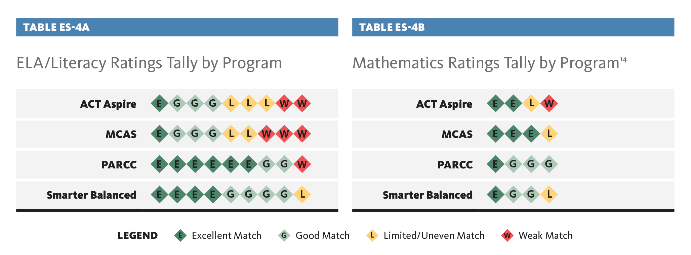
Grades 5/8 Ratings Tally by Subject and Program

Slide 12
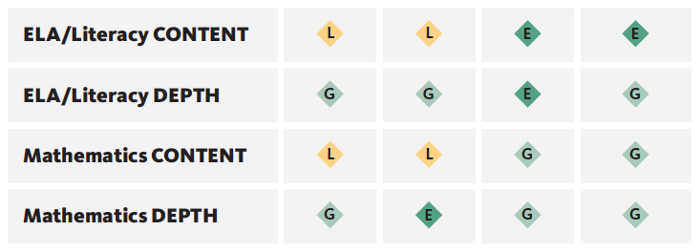
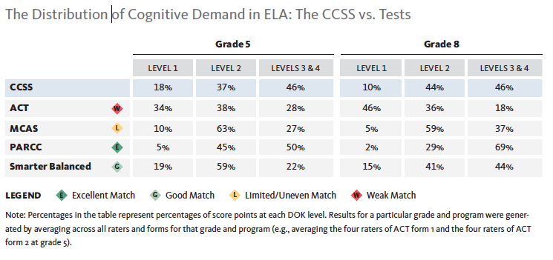
Overall Content and Depth Ratings for Grades 5 and 8 ELA/Literacy and Mathematics
Smarter Balanced
ACT Aspire
MCAS
PARCC

Slide 13
Overall Content and Depth Ratings for High School ELA/Literacy and Mathematics
Criteria | ACT Aspire | MCAS | PARCC | SBAC
ELA/Literacy CONTENT | W | L | E | E
ELA/Literacy DEPTH | G | L | L | E
Mathematics CONTENT | L | G | E | E
Mathematics DEPTH | G | L | G | E

Slide 14
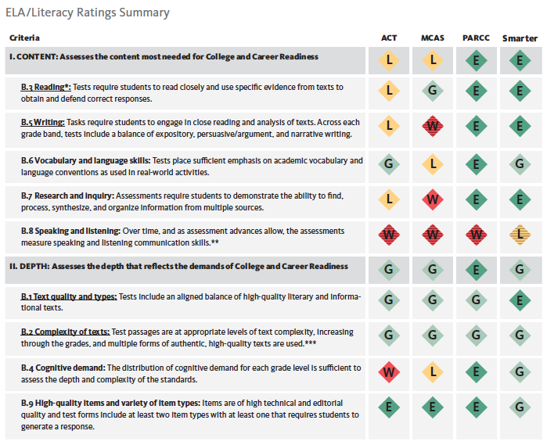
ELA/Literacy
Content
Ratings
Summary: Grades 5/8
ACT
Aspire
MCAS
PARCC
Smarter Balanced
Criteria

Slide 15
ELA/Literacy Content Sub-Criteria by Program

Slide 16
ELA/Literacy
Depth
Ratings
Summary:
Grades 5/8
Criteria
ACT
Aspire
MCAS
PARCC
Smarter Balanced

Slide 17
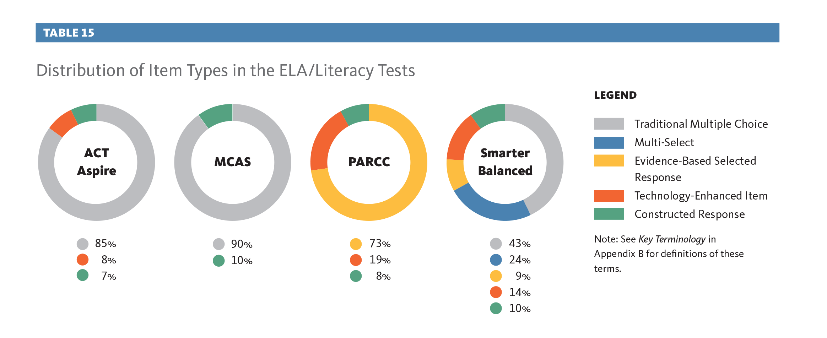
Criterion B.9 - Distribution of Item Types in ELA/Literacy Tests (Grades 5 and 8)

Slide 18
ELA/Literacy Depth Sub-Criteria by Program

Slide 19
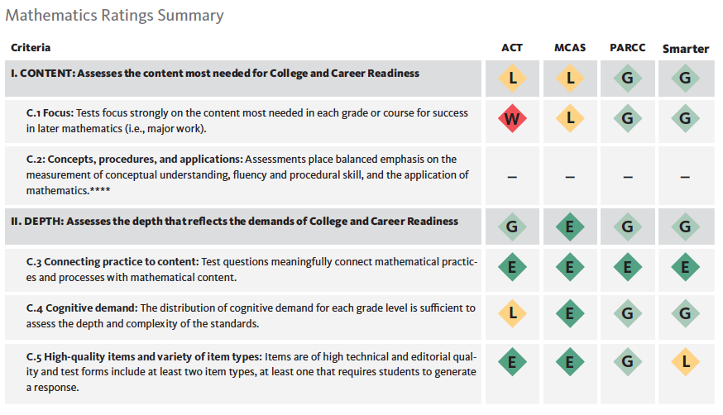
Mathematics Content
Ratings
Summary;
Grades 5/8
Criteria
ACT
Aspire
MCAS
PARCC
Smarter Balanced

Slide 20
Mathematics Content Sub-Criteria by Program

Slide 21
Mathematics Depth
Ratings
Summary: Grades 5/8
ACT
Aspire
MCAS
PARCC
Smarter Balanced
Criteria

Slide 22
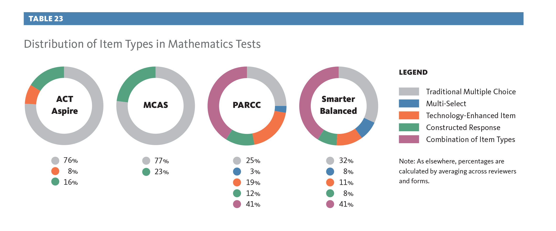
Criterion C.9 - Distribution of Item Types in Mathematics Tests (Grades 5 and 8)

Slide 23
Mathematics Depth Sub-Criteria by Program

Slide 24
PARCC Program Strengths and Areas for Improvement: Grades 5/8
Strengths ELA/Literacy
Includes suitably complex texts
Requires a range of cognitive demand
Demonstrates variety in item types
Requires close reading
Assesses writing to sources, research, and inquiry
Emphasizes vocabulary and language skills
Strengths Mathematics
Reasonably well aligned to the priority content at each grade level
Includes a distribution of cognitive demand that is similar to that of the standards at grade 5
Areas for Improvement ELA/Literacy
Use of more research tasks requiring students to use multiple sources
Developing the capacity to assess speaking and listening skills
Areas for Improvement Mathematics
Further focus on the prioritized content at grade 5
Addition of more items at grade 8 that assess standards at DOK 1
Increased attention to accuracy of the items—primarily editorial, but in some instances mathematical

Slide 25
Smarter Balanced Program Strengths and Areas for Improvement: Grades 5/8
Strengths ELA/Literacy
Assesses the most important ELA/Literacy skills of the CCSS, using technology in ways that both mirror real-world uses and provide quality measurement of targeted skills
Strong in its assessment of writing, research, and inquiry
Assesses listening with high quality items that require active listening (unique among the four programs)
Strengths Mathematics
Provides adequate focus on the major work of the grade
Areas for Improvement ELA/Literacy
Improving its vocabulary items
Increasing the cognitive demand in grade 5 items
Developing the capaciy to assess speaking skills
Areas for Improvement Mathematics
Increased focus on the major work at grade 5
Increase the number of items on the grade 8 tests that assess standards at the lowest level of cognitive demand
Removal of serious mathematical and/or editorial flaws, found in approximately one item per form

Slide 26
ACT Aspire Program Strengths and Areas for Improvement: HS ELA/Literacy
Strengths
Research items required students to analyze, synthesize, organize, and use information
Approximately two-thirds of the texts were informational
Nearly all passages were previously published/of publishable quality
Majority of informational passages were expository
Distribution of cognitive demand matched the cognitive demand distribution of the CCSS as a whole
Score points associated with DOK levels 3/4 approximately matched the percentage of CCSS at DOK levels 3/4
Areas for Improvement
Many items did not require close reading or analysis of text.
Most items did not focus on central ideas
Most items were not aligned to the specifics of the standards
Most items did not require students to support their answers with evidence
Writing prompt did not require students to confront text or other stimuli directly
Few tier 2 words were used to assess vocabulary
Only one expository writing prompt was included

Slide 27
MCAS Program Strengths and Areas for Improvement: HS Mathematics
Strengths
Most of the test measured content considered important and aligned to prerequisites for college and careers
Items were free of technical and editorial issues
Various item types were represented and one of those types required students to generate a response
Areas for Improvement
Some CCSS were assessed multiple times while others were not assessed at all
Form did not have recommended balance of conceptual understanding, procedural skill /fluency /application
Low level of cognitive complexity required for conceptual understanding items
There was too much coverage of the lower levels of cognitive demand

Slide 28
Accessibility Summary
MCAS’ accommodations and accessibility were limited and had not kept pace with advancements in the field.
ACT Aspire, PARCC and Smarter Balanced all provide a range of reasonably well documented accessibility features and accommodations.
Currently, ACT Aspire has the fewest number of accessibility features; for instance they have braille, American Sign Language and word-to-word dictionaries in most languages and recently incorporated highlighting and color overlay as a universal tool for their 2015-2016 online assessment. They do not yet have expandable passages.
Smarter Balanced has the most forward-thinking features for an online test including pop-up glossaries, expandable passages, and streamline (simplified format).

Slide 29
Recommendations
Programs
Ensure every item meets highest standards for editorial accuracy and technical quality
Use technology-enhanced items (TEI) strategically to improve test quality/enhance student effort
Prioritize set of knowledge/skills at each grade to serve as focus of instruction and build public understanding/support
Recognize value of CCSSO criteria
Methodology
Include a list of detailed metadata requirements for each rating
Refine DOK rating
Improve measures of mathematical practices

Slide 30
Closing
Thoughts
Life--and tests--are full of tradeoffs:
Testing time
Cost
Autonomy
The unique factor
Comparability

Slide 31
Thank you for your time.
Questions?
anorthern@edexcellence.net
sschultz@humrro.org

